Slide 1

LINEAR FUNCTIONS and models week 2
Properties, Equations, and Graphs

Slide 2
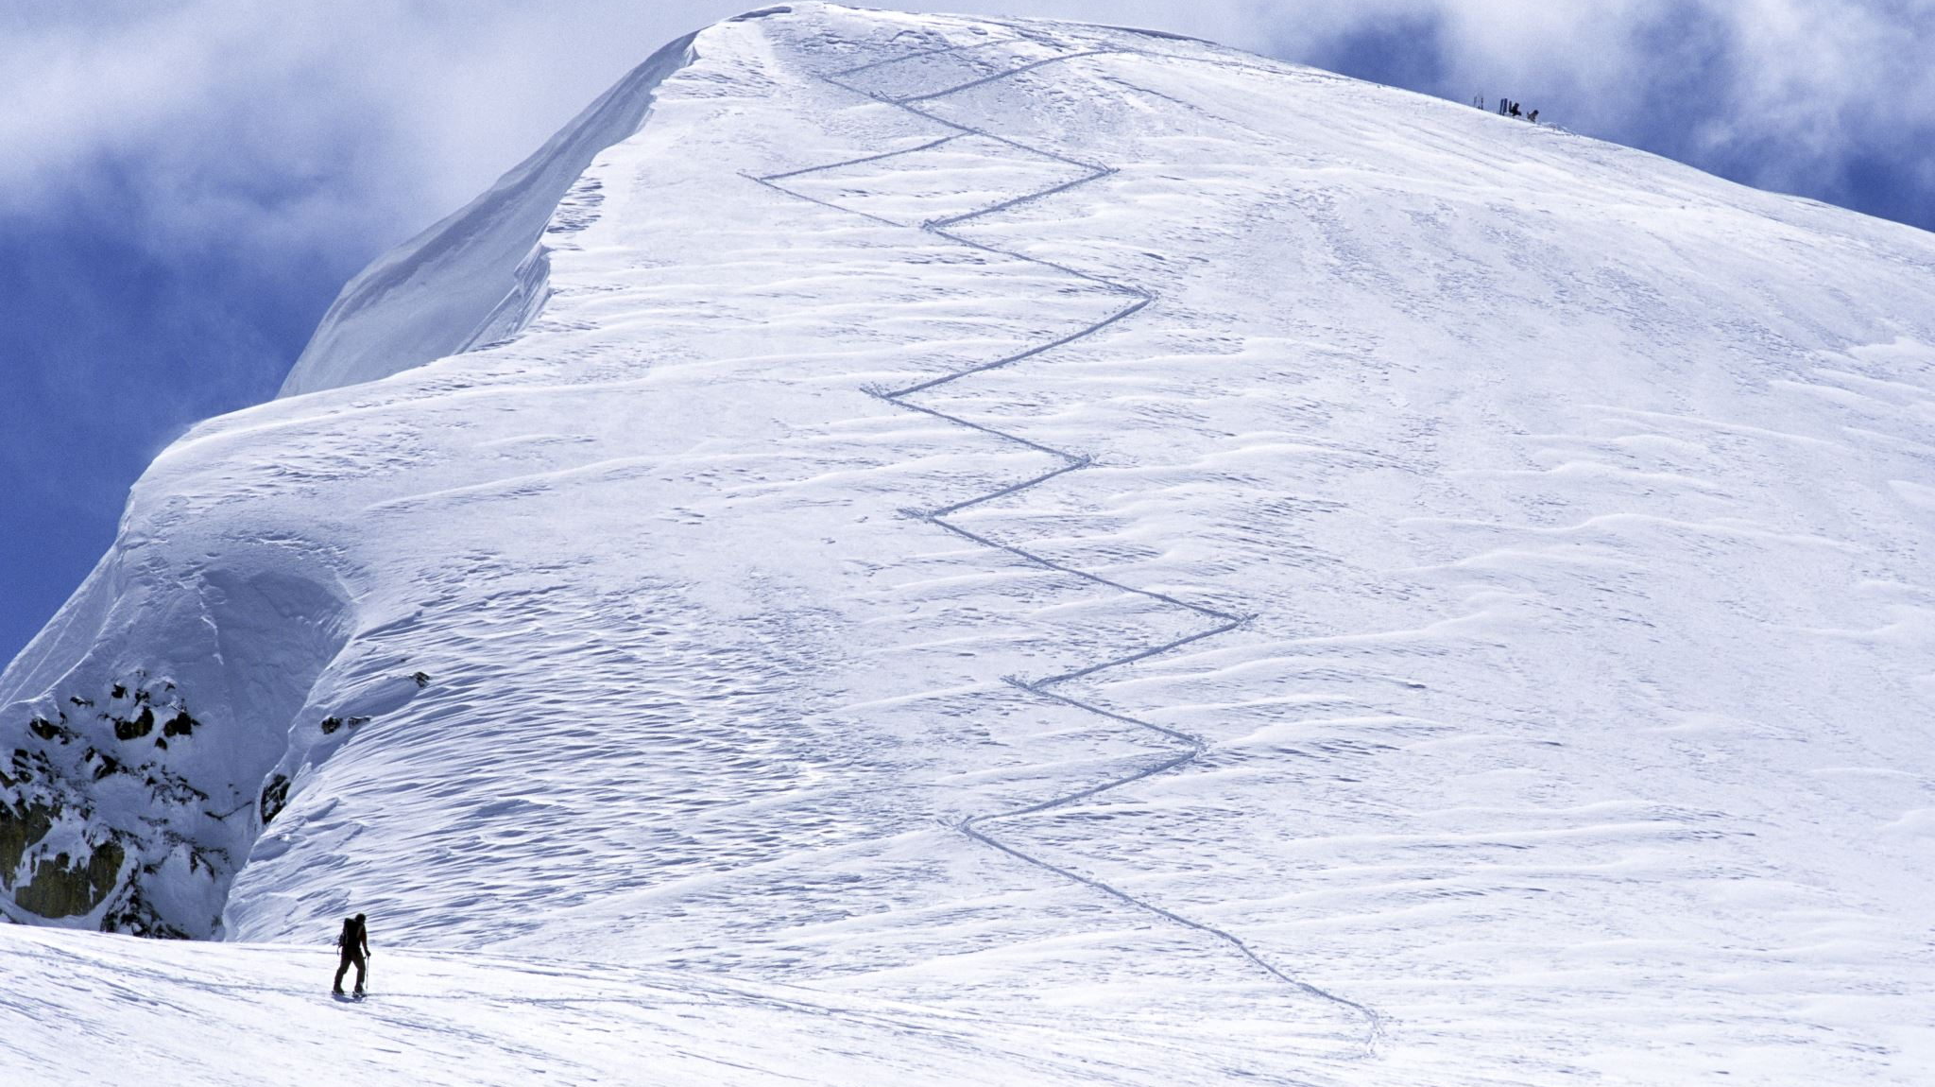
SLOPE of a LINE

Slide 3
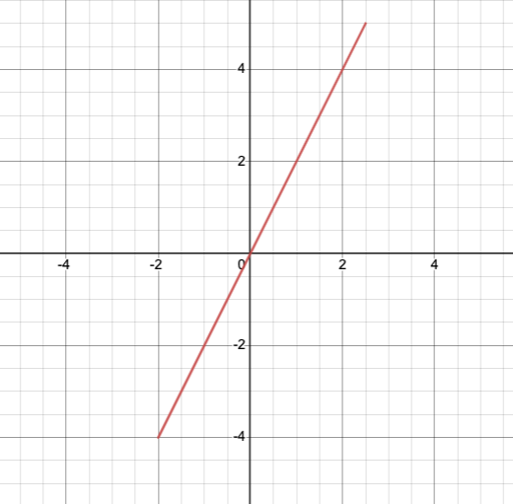
SLOPE is a measure of slant or ascent/ descent
This line has POSITIVE slope. Why?

Slide 4
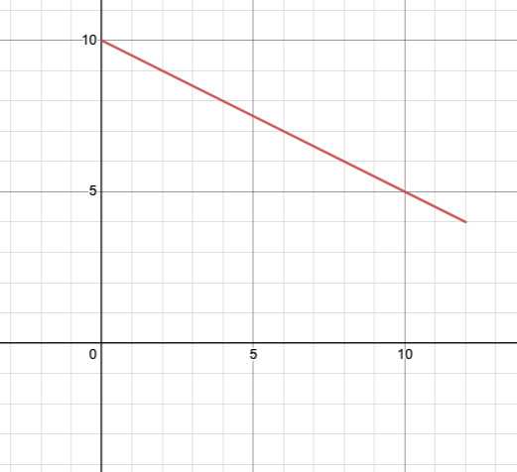
SLOPE is a measure of slant or ascent/ descent
This line has NEGATIVE slope. Why?

Slide 5
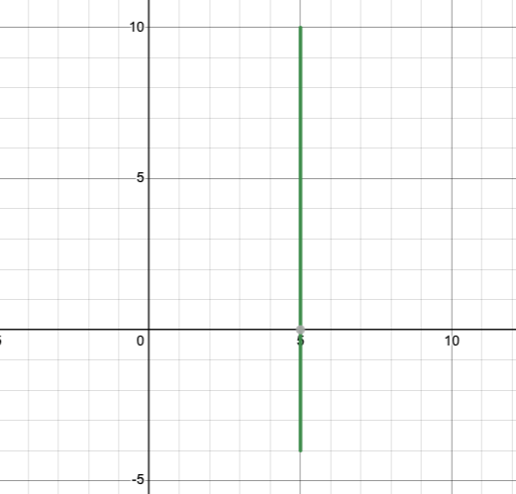
SLOPE is a measure of slant or ascent/ descent
This line has NO slope (UNDEFINED). Why?

Slide 6
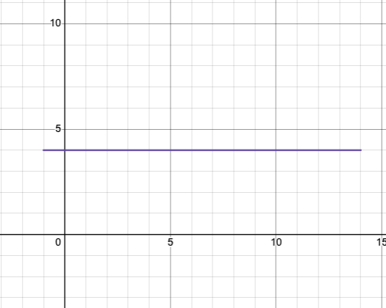
SLOPE is a measure of slant or ascent/ descent
This line has slope = 0 (FLAT LINE). Why?

Slide 7
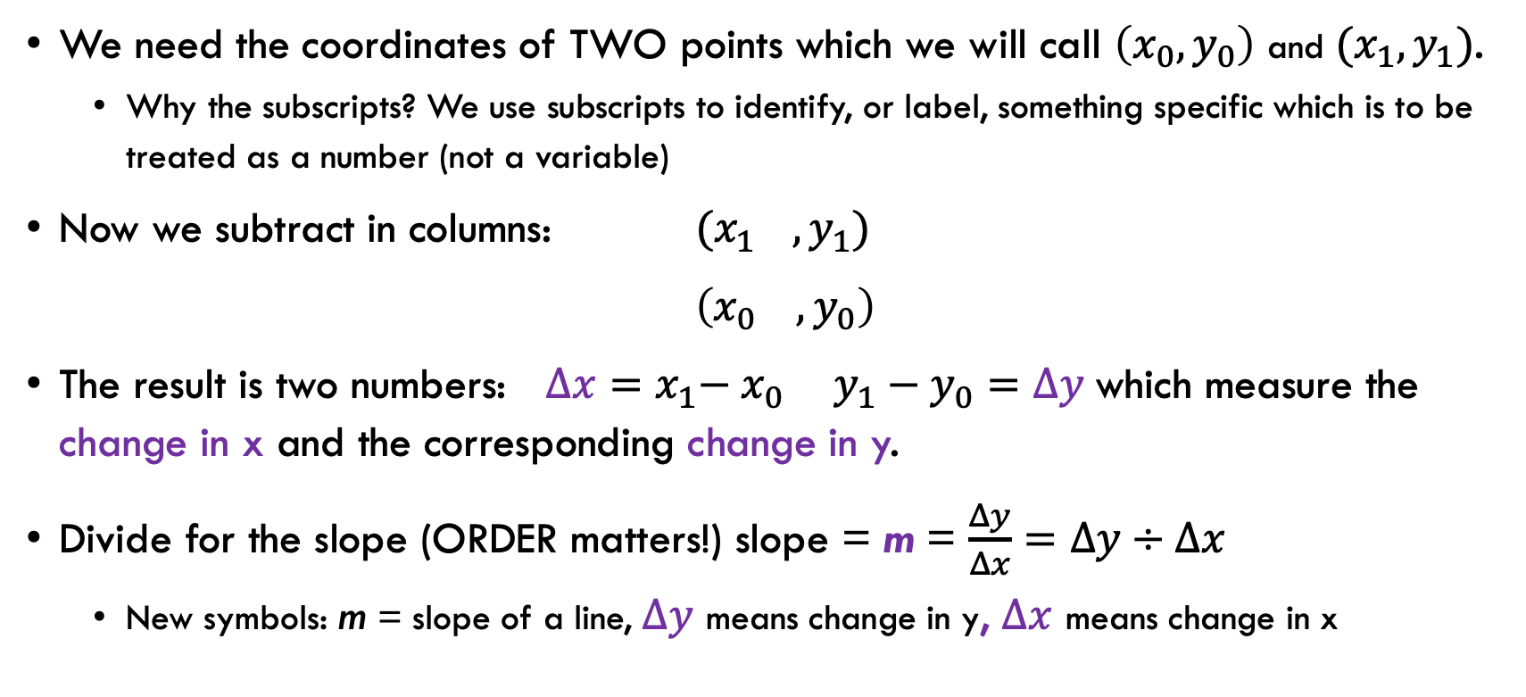
HOW DO WE CALCULATE SLOPE?
We need the coordinates of TWO points which we will call $\left(x_{0},y_{0}\right)$ and $(x_{1}, y_{1})$.
Why the subscripts? We use subscripts to identify, or label, something specific which is to be treated as a number (not a variable)
Now we subtract in columns: $(x_{1 }, y_{1})$
$\left(x_{0} ,y_{0}\right)$
The result is two numbers:${ ∆x=x}_{1}− x_{0}$ $y_{1}−y_{0}=∆y$ which measure the change in x and the corresponding change in y.
Divide for the slope (ORDER matters!) slope = m = $\frac{Δy}{Δx}=∆y÷∆x$
New symbols: m = slope of a line, $∆y$ means change in y, $∆x$ means change in x

Slide 8
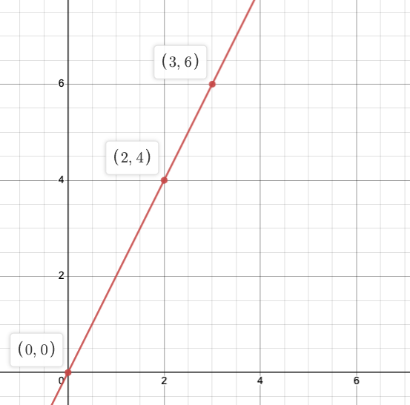
Calculate slope from a graph and two points
LINE POS
SLOPE = 2

Slide 9
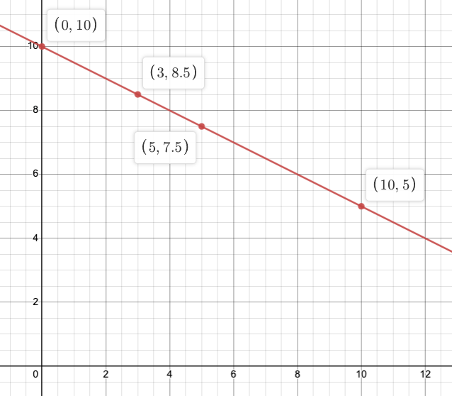
Calculate slope from a graph and two points
LINE NEG
SLOPE = -0.5

Slide 10
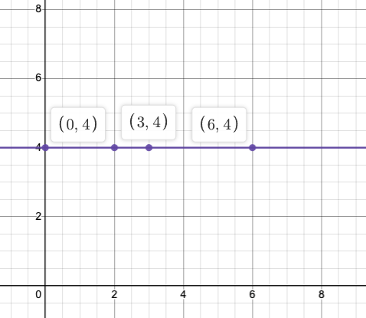
Calculate slope from a graph and two points
LINE HORIZONTAL
SLOPE = 0

Slide 11
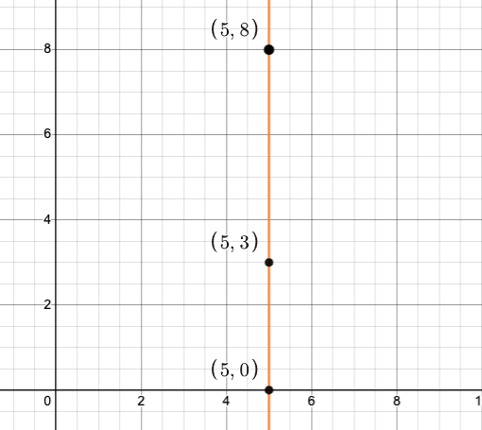
Calculate slope from a graph and two points
LINE VERTICAL
SLOPE IS UNDEFINED
NO SLOPE

Slide 12
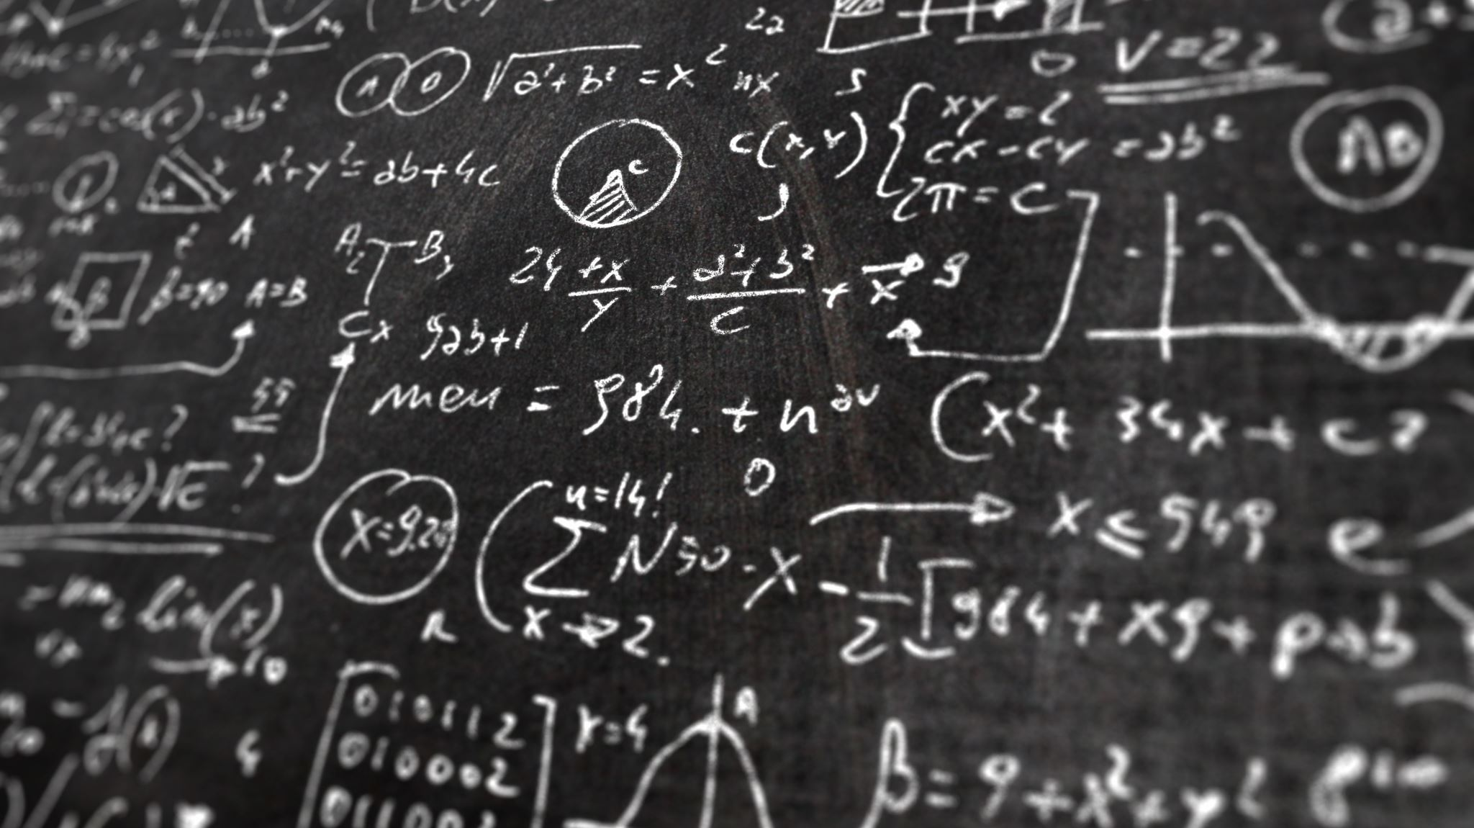

EQUATION OF A LINE

Slide 13
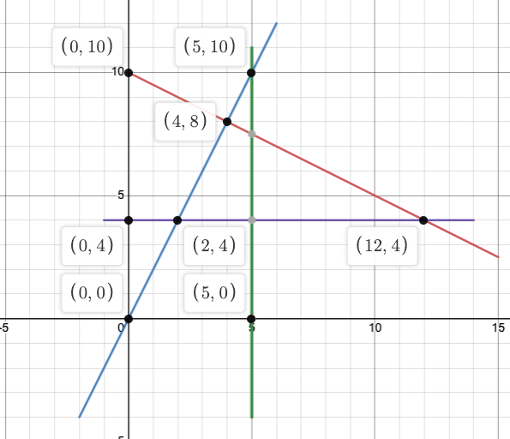
Y Intercept of a Line
What is an intercept?
It is the location where the line crosses the y axis
It is the y value when x is 0
Notice vertical lines never touch the y axis
Every line has one! (except vertical lines)
What are the y-intercepts shown here?

Slide 14
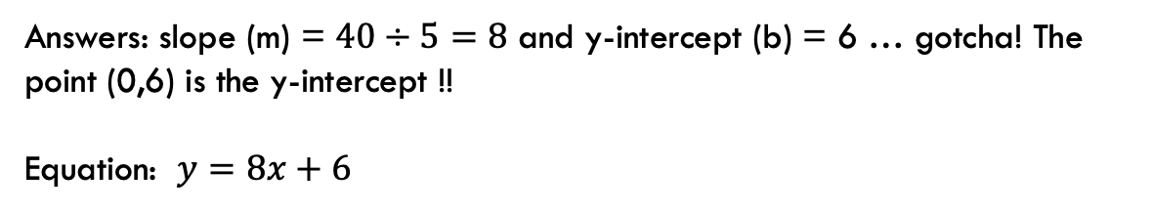

How do we write the equation?
The equation of any line is in the form: $f\left(x\right)=y=mx+b$
m is the slope (which is calculated given any two points)
The number b is the y-intercept. We may need to solve for b. If so, we use $b=y−m⋅x$ with (x,y) a point on the line and m = slope
Example: If $m = 3$and $b = − 8$the equation will be:
$$y=3x−8$$
Can you? Find the slope and y-intercept of a line that passes through the points (0, 6) and (5, 46)?
Then use those numbers to write the equation
Answers: slope (m) = $40÷5=8$ and y-intercept (b) = 6 … gotcha! The point (0,6) is the y-intercept !!
Equation: $y=8x+6$

Slide 15
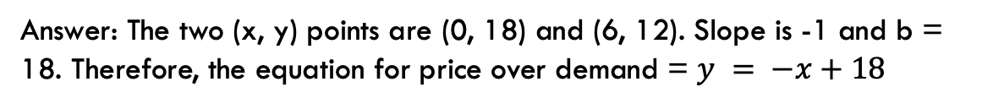

How do we write the equation?
In business, we often use linear equations for supply and demand. The y variable represents price, and the x variable represents quantity.
So $y = mx + b$ means something specific.
1) The value of b will be the price then quantity = 0
2) The value of m will be measuring change in price over change in quantity
Use caution when looking at supply/demand examples on Youtube. Equations are given quantity as a function of price.
Suppose quantity demanded is 0 when price is $18. Consumer demand goes up to 6 when the price is at $12. What is the demand equation in this situation?
Answer: The two (x, y) points are (0, 18) and (6, 12). Slope is -1 and b = 18. Therefore, the equation for price over demand = $y = −x+18$

Slide 16
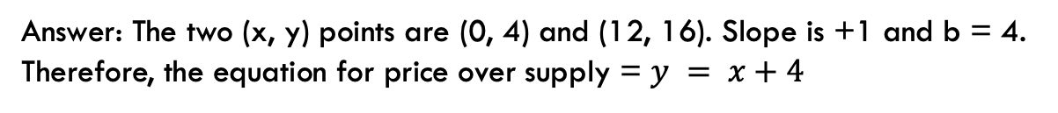

How do we write the equation?
In business, we often use linear equations for supply and demand. The y variable represents price, and the x variable represents quantity.
So $y = mx + b$ means something specific.
1) The value of b will be the price then quantity = 0
2) The value of m will be measuring change in price over change in quantity
Use caution when looking at supply/demand examples on Youtube. Equations are given as quantity as a function of price.
Suppose quantity supplied is 0 when price is $4. Supply goes up to 12 when the price is at $16. What is the supply equation in this situation?
Answer: The two (x, y) points are (0, 4) and (12, 16). Slope is +1 and b = 4. Therefore, the equation for price over supply = $y = x+4$

Slide 17

Make a graph
Your turn: Make a graph of the supply and demand equations that we just found.
Set up a table of values. Choose 3 or 4 values of x and calculate the y values that correspond to the chosen values of x.
Plot the points. Label the supply and demand.
Equilibrium is accomplished when supply equals demand at a certain price. How would we go about finding the equilibrium in this example?

Slide 18
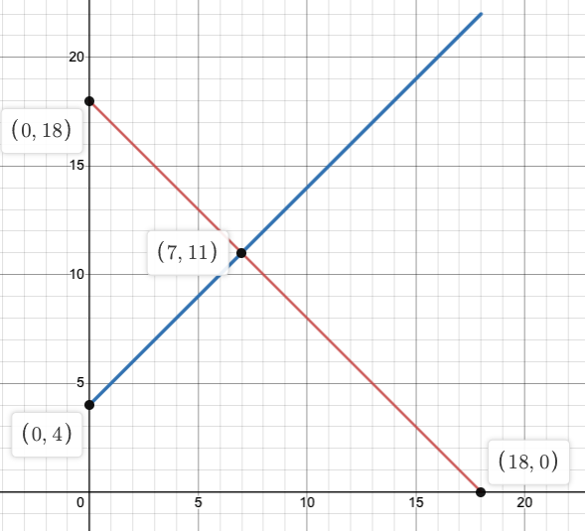
Supply and Demand lines
SUPPLY
The slope of demand is always negative (quantity demanded goes UP as price goes DOWN)
Supply slope is always positive (quantity in supply goes UP as price goes UP)
The point where the two graphs intersect is called the equilibrium point. Where supply equals demand.
DEMAND
Equilibrium occurs when price is $11

Slide 19

Cost, revenue, and profit example (LINEAR)

Slide 20
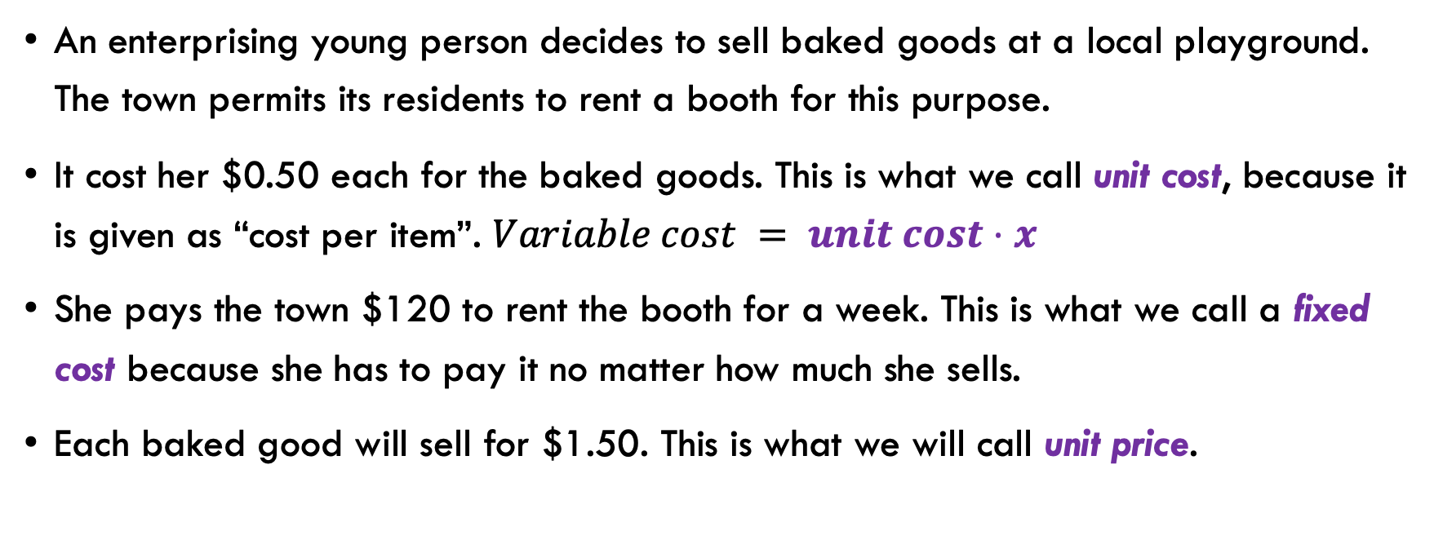
Writing cost and revenue equations
An enterprising young person decides to sell baked goods at a local playground. The town permits its residents to rent a booth for this purpose.
It cost her $0.50 each for the baked goods. This is what we call unit cost, because it is given as “cost per item”. $Variable cost = unit cost⋅x$
She pays the town $120 to rent the booth for a week. This is what we call a fixed cost because she has to pay it no matter how much she sells.
Each baked good will sell for $1.50. This is what we will call unit price.

Slide 21

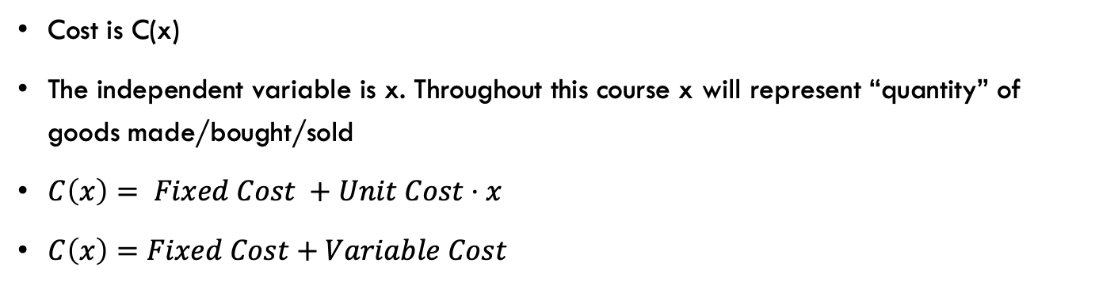
Writing cost equation
Cost is C(x)
The independent variable is x. Throughout this course x will represent “quantity” of goods made/bought/sold
$C\left(x\right)= Fixed Cost +Unit Cost⋅x$
$C\left(x\right)=Fixed Cost+Variable Cost$
$$C\left(x\right)=120+0.50x$$

Slide 22

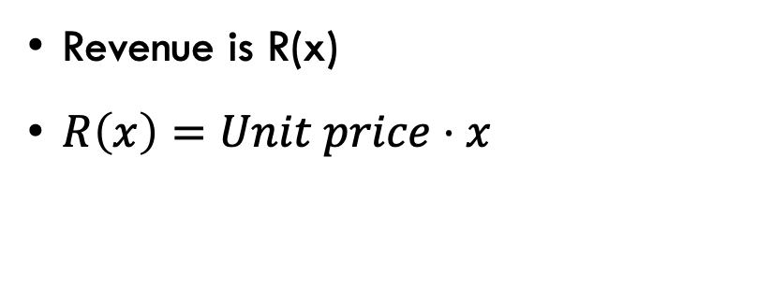
Writing revenue equation
Revenue is R(x)
$R\left(x\right)=Unit price⋅x$
$$R\left(x\right)=1.5x$$

Slide 23
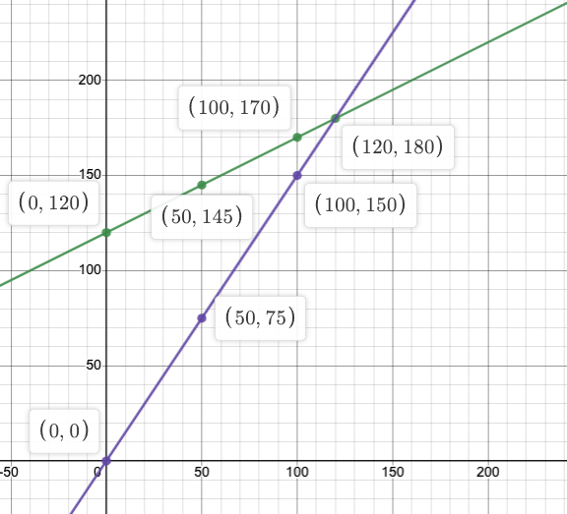
Graph of cost and revenue
COST
Make a graph of cost and revenue. Make sure to label COST and REVENUE.
Use x values of 0, 50, 100, and 120 in a table of values.
What is the meaning of the point where cost and revenue intersect?
REVENUE
Answer: (120,180) is called the break-even point. She needs to sell more than 120 baked goods before starting to make $.

Slide 24

Profit equation
Profit is given the name P(x)
$P\left(x\right)=R\left(x\right)−C\left(x\right)$
$P\left(x\right)=1.5x−\left(120+0.5x\right)$
$P\left(x\right)=1.5x−120−0.5x$
$P\left(x\right)=1.0x−120$
$P\left(x\right)=x−120$

